Slide 1

Voice Tech in Healthcare

Slide 2

Aishwarya
Samruddhi
Sumit
Swasti
Abhishek

Slide 3
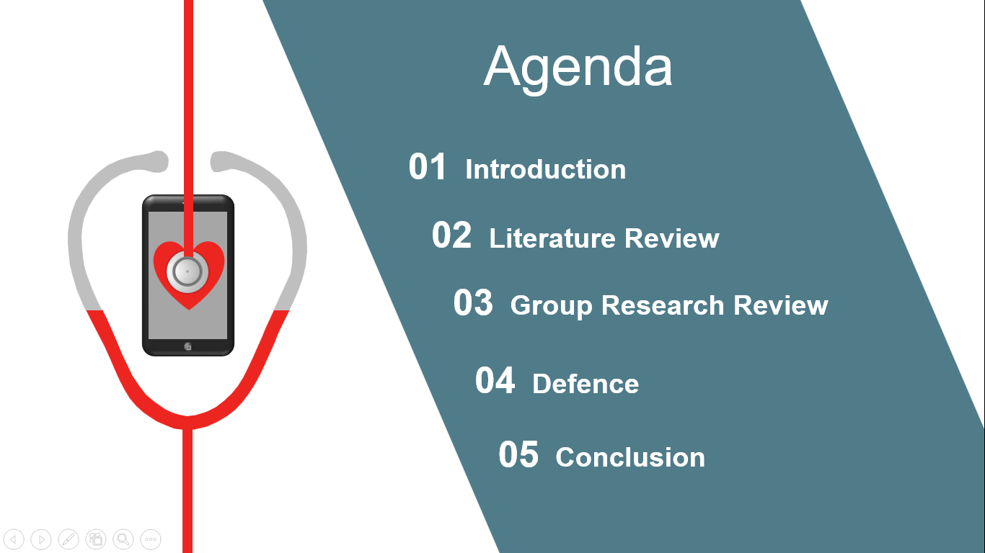

Slide 4
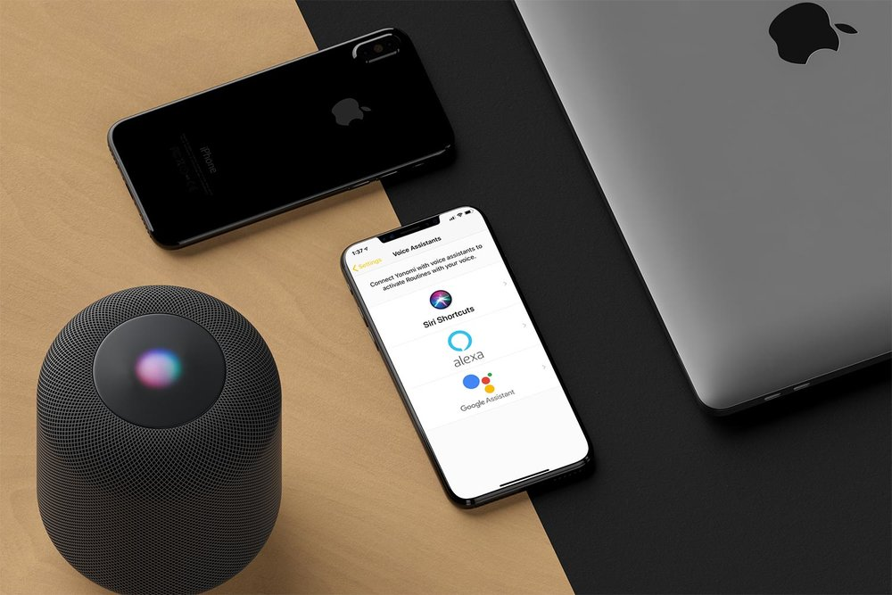
Why Voicetech in Healthcare?

Slide 5
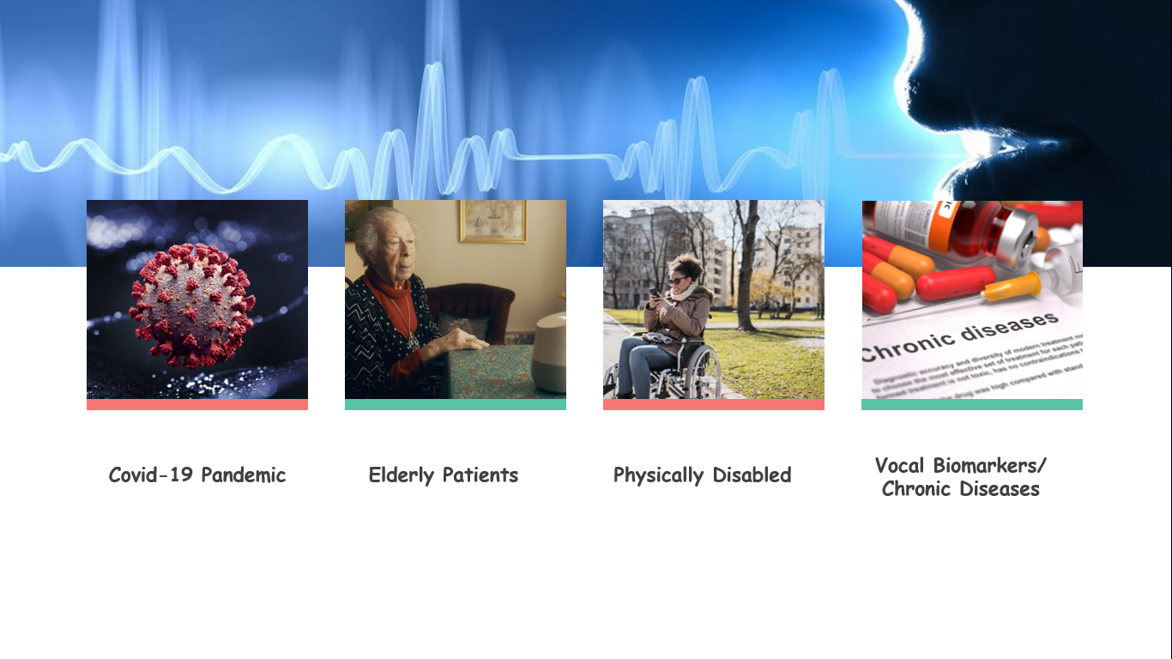

Slide 6

Literature
Review

Slide 7

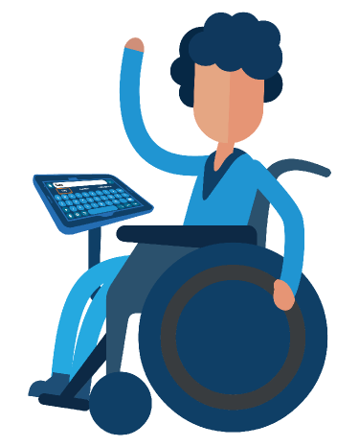
Accessibility came by Accident: Use
of voice controlled intelligent personal assistants by people with disabilities
Difficulties in remembering voice commands
Speech output challenges for the users with hearing
The need to enunciate clearly and speak loudly
- Alisha Pradhan, Kanika Mehta, Leah Findlater

Slide 8
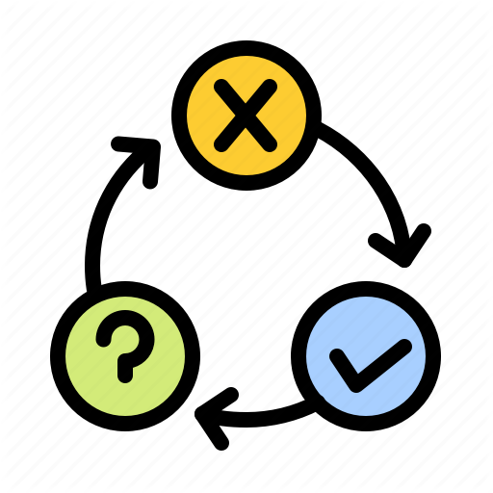
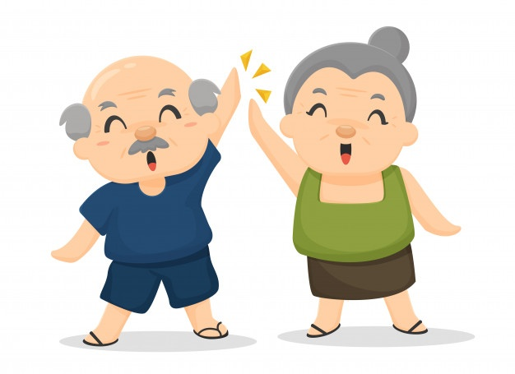
Voice Assistants and Older People
Sergio Sayago, Barbara Barbosa Neves, Benjamin R Cowan
Failure to provide appropriate response
Accessibility and use challenges
How VA’s should talk to Older People

Slide 9

Vocal signal analysis in patients affected by Multiple Sclerosis
Inaccuracy in detecting the diseases
Lack of physical human interaction
Technical challenges resulting to patient injury
Misunderstanding requests and the nuances of human dialogue
Privacy and Security Challenges
A Scoping Review of Patient-Facing, Behavioral Health Interventions with Voice Assistant Technology Targeting Self-management and Healthy Lifestyle Behaviors

Slide 10

Covid - 19 and HealthCare’s Digital Revolution
Chronic patients have to choose between getting exposed to Covid-19 Vs postponing medical care needed
In a 2019 Price Waterhouse Cooper survey, 38% of chief executive officers of U.S. health care systems reported having no digital component in their overall strategic plan
The risk of fraud resulting from adoption of digital services in health care

Slide 11
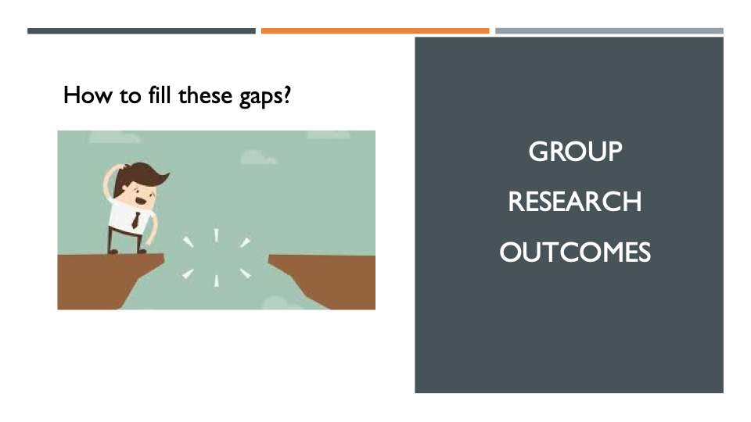
How to fill these gaps?
GROUP RESEARCH OUTCOMES

Slide 12
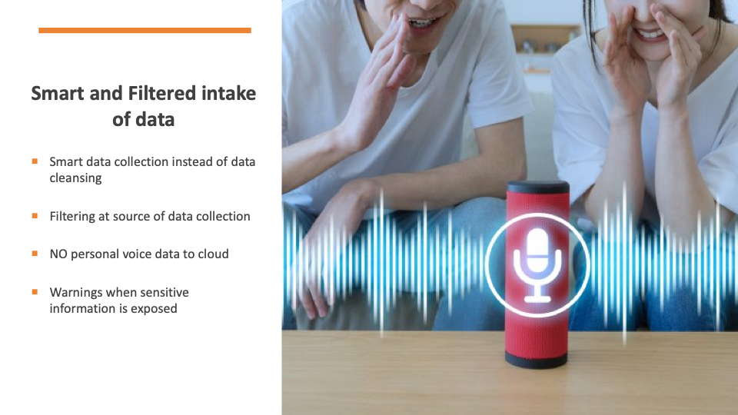

Slide 13
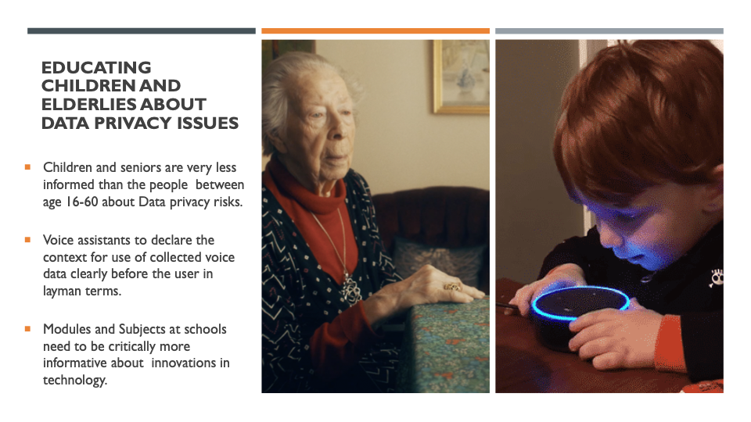

Slide 14
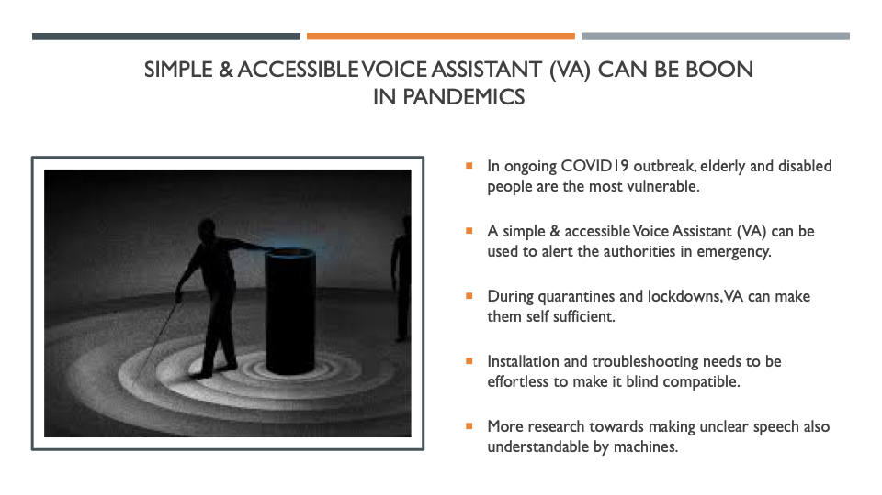

Slide 15
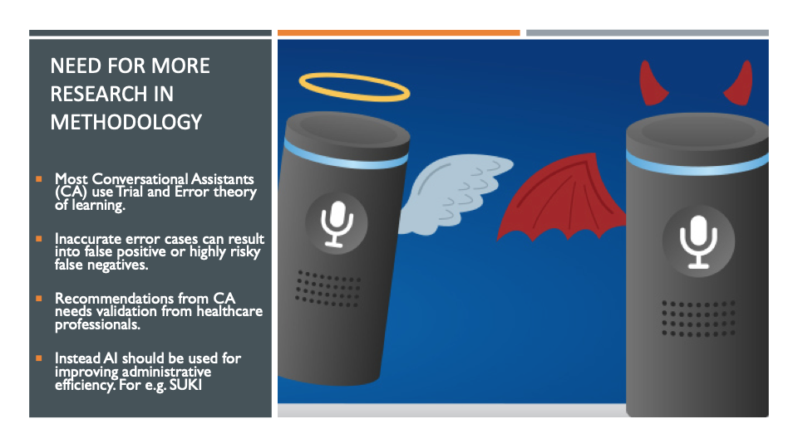

Slide 16

Defence
Why?
Importance?
Why have others failed to consider?

Slide 17
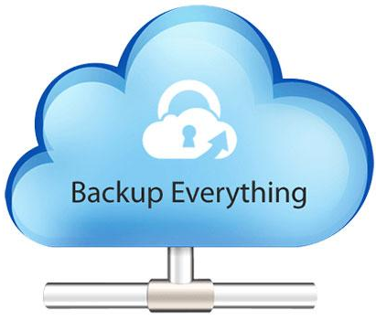

Why this Research?
Digital Natives have heavy Digital Footprint
Cloud storage philosophy
Notes:
At Source: Data is stored on multiple cloud servers for redundancy and reliability. Controlling it at source is much safer than planning for access controls later when the data is already out there.
Educating: The education around data privacy needs to start early as today’s children are ‘Digital Natives’ and they start creating their Digital Footprint very early on

Slide 18
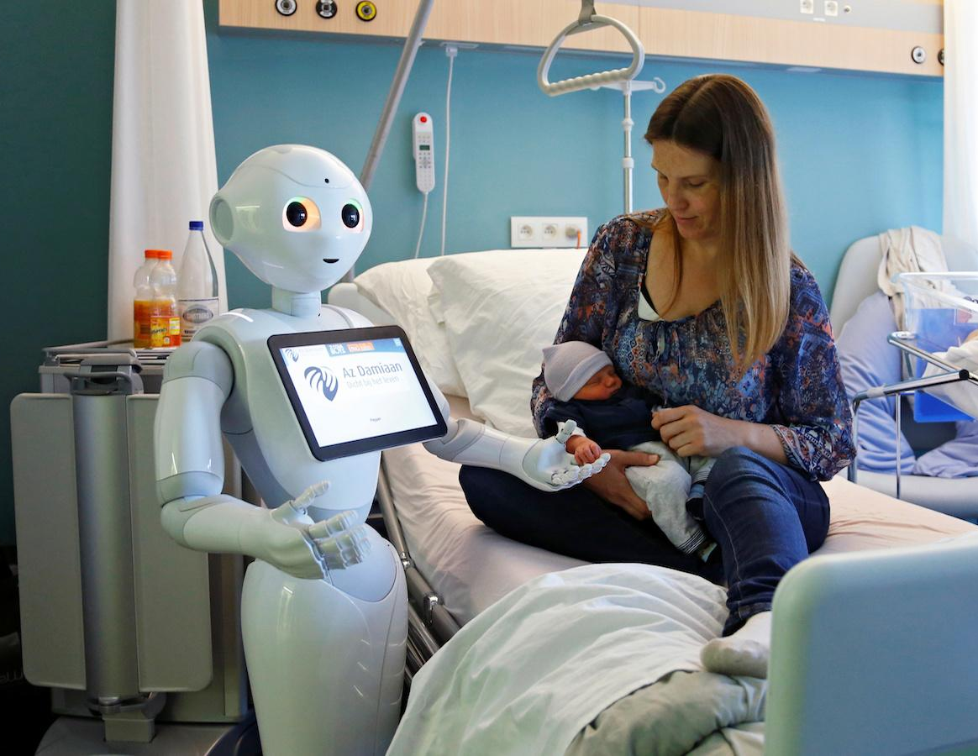

Why this Research?
Discretion on HIPAA compliant Tech
Cost of a mistakes someone’s life
Notes:
Errors: Mistakes can be costly and may lead to fatalities or grave consequences
HIPAA: Discretion or extended surveillance

Slide 19
Why is it Important?
Accountability?
Patient Info Anonymised?
HIPAA
Who manages the data?
- Who pays for storage?
- What can’t be done?
Who Owns the Data?
Notes:
Who will own the data?
Who will manage the data?
What can/can’t be done with it?
Who will pay for data storage?
Is the technology HIPAA compliant?
Would the patient information be anonymised?
Accountability Issues
Who would be responsible for incorrect prescription?
Identity impersonation

Slide 20
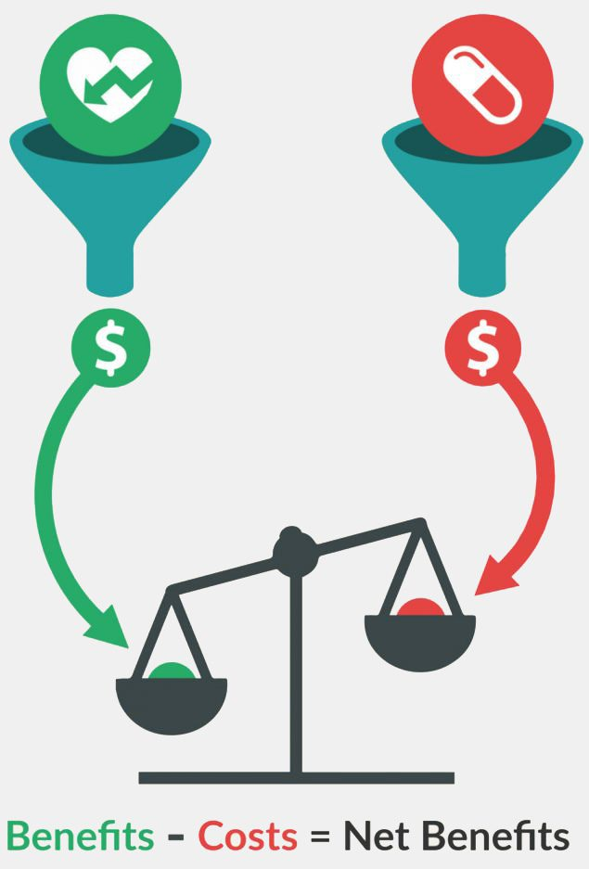
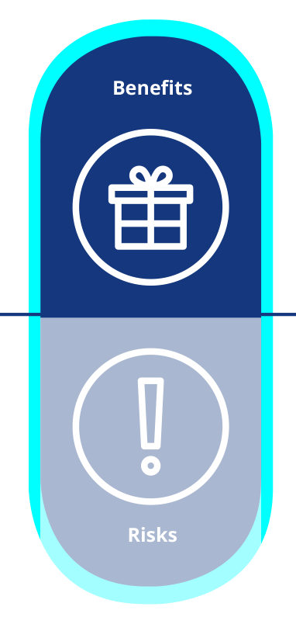
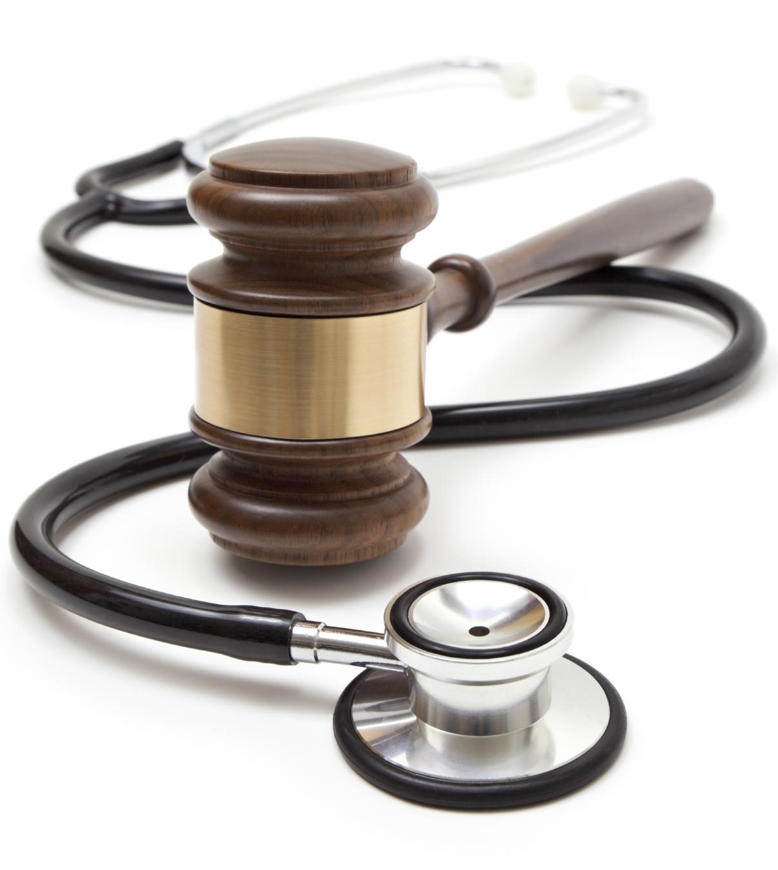
Why others failed to consider it?
Legal Complications
Costs vs Revenues
Benefits vs Risks
Notes:
Narrative built around benefits outweighing the risks - Commercial actors
Healthcare is much more complicated than retail or consumer electronics - Legal issues
Cost-Benefit Analysis throws higher costs than perceived benefits for investors
Quote ‘Do Artefacts have Politics’ as corporates and government

Slide 21
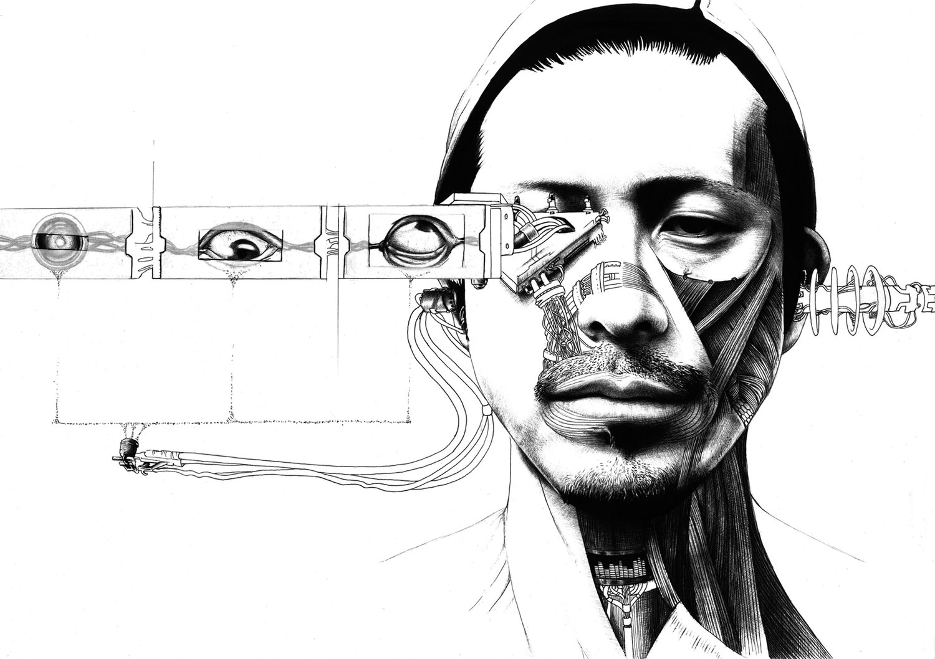
Do Cyborgs have Politics?

Slide 22

What have we concluded from the research?
Instant speech to text conversion.
Aiding with the prescription.
Provide accurate, useful responses about health
Voicetech in the Aarogya Setu application.

Slide 23
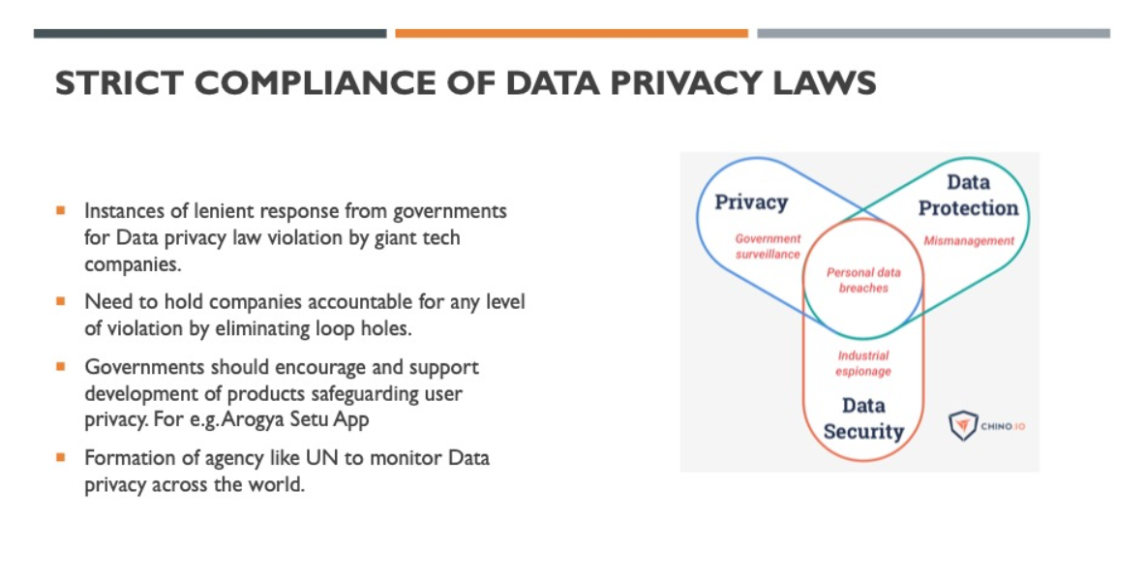


Slide 24

“‘Mistakes’ is the word you’re too embarrassed to use. You ought not be. You’re the product of a trillion of them. Evolution forged the entirety of sentient life on this planet using only one tool: the mistake’.”
‘Mistakes’ is the word you’re too embarrassed to use. You ought not be. You’re the product of a trillion of them. Evolution forged the entirety of sentient life on this planet using only one tool: the mistake!

Slide 25

Voicetech in healthcare is a kind of mirror and at the same time, a potential way of restoring our ethics!

Slide 26
